Slide 1
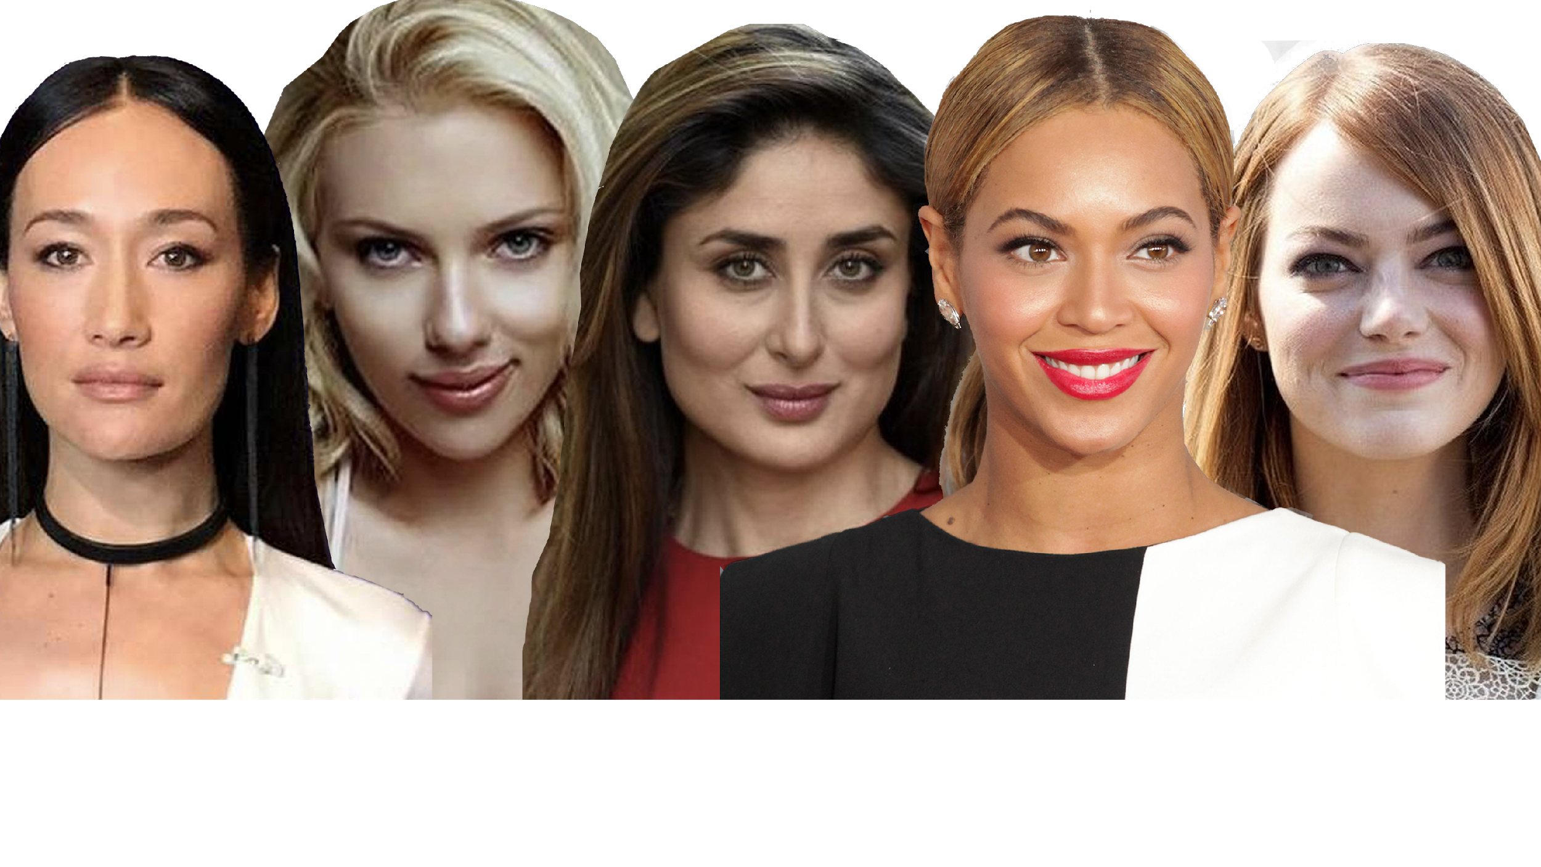
DSI-16 Capstone Project Face Shape Classification
oblong
square
oval
round
heart
Pratchayanee
Luepuwapitakkul

Slide 2
Agenda
Problem Statement
Project Approach
Data Exploration & Pre-processing
Modelling & Evaluation
CNN built from scratch
CNN with transfer learning (VGG-Face)
Conclusions
Next Steps

Slide 3
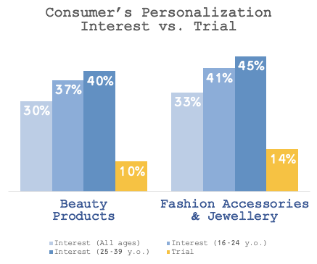
Problem Statement:
Enable personalization in Beauty & Fashion
Source: The Deloitte Consumer Review: Made-to-order The rise of mass personalization.
https://www2.deloitte.com/content/dam/Deloitte/ch/Documents/consumer-business/ch-en-consumer-business-made-to-order-consumer-review.pdf

Slide 4
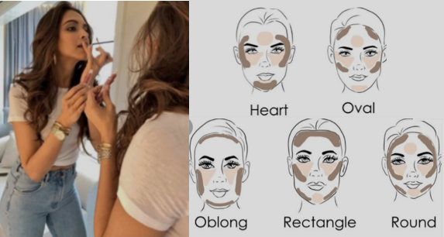
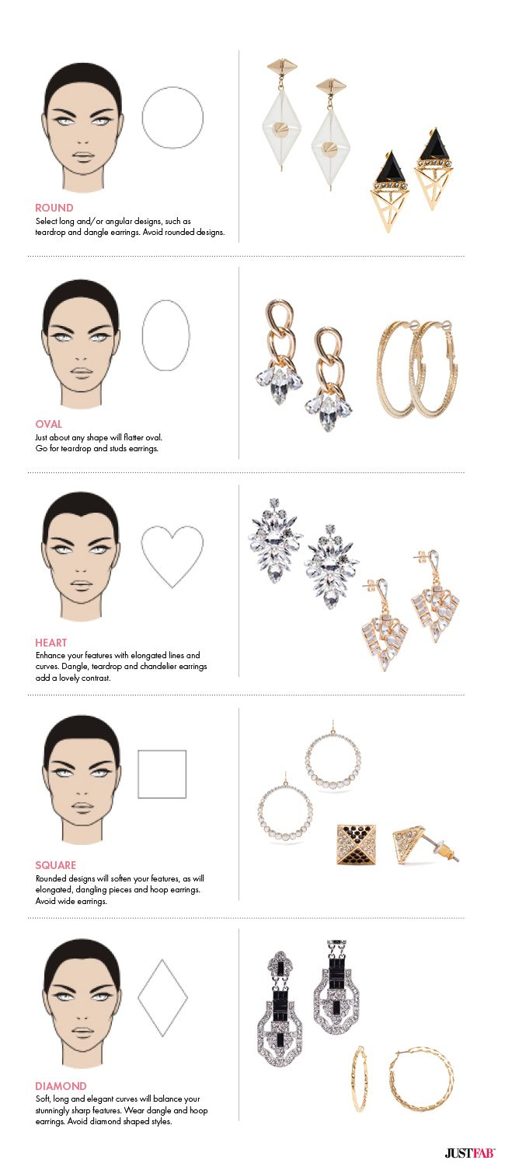
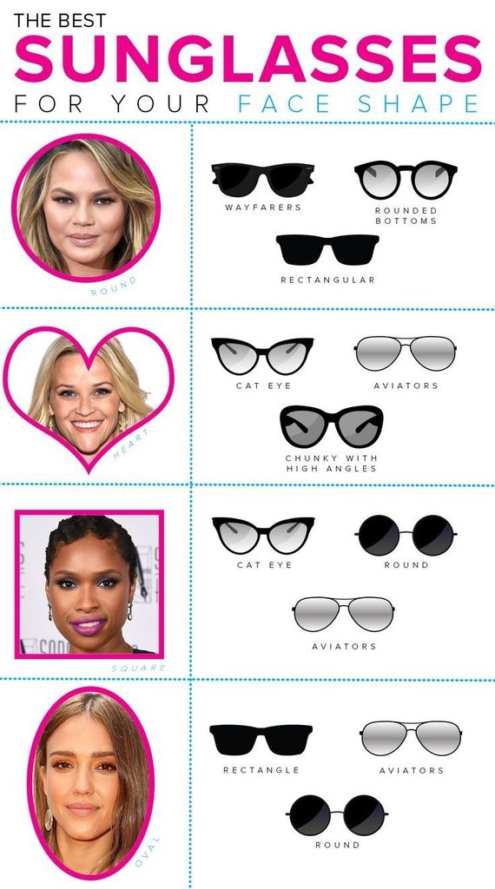
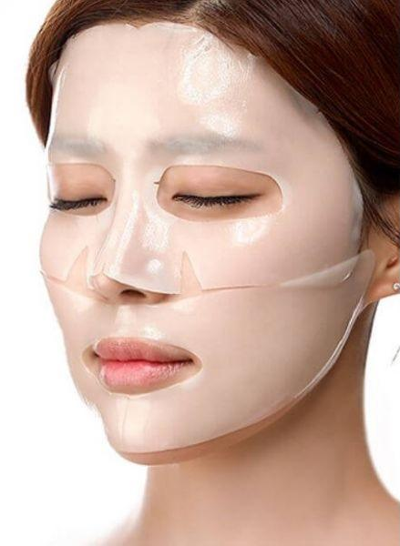
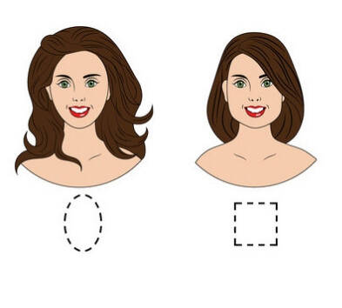
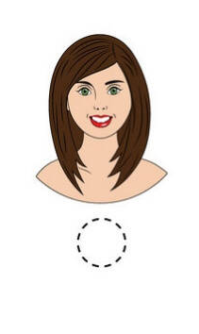
Problem Statement:
Enable personalization in Beauty & Fashion
EARRINGS
Make-Up
Face Mask
Hair Style

Slide 5


Deep Learning
with Convolutional Neural Network
(CNN)
Evaluation: ACCURACY

Slide 6
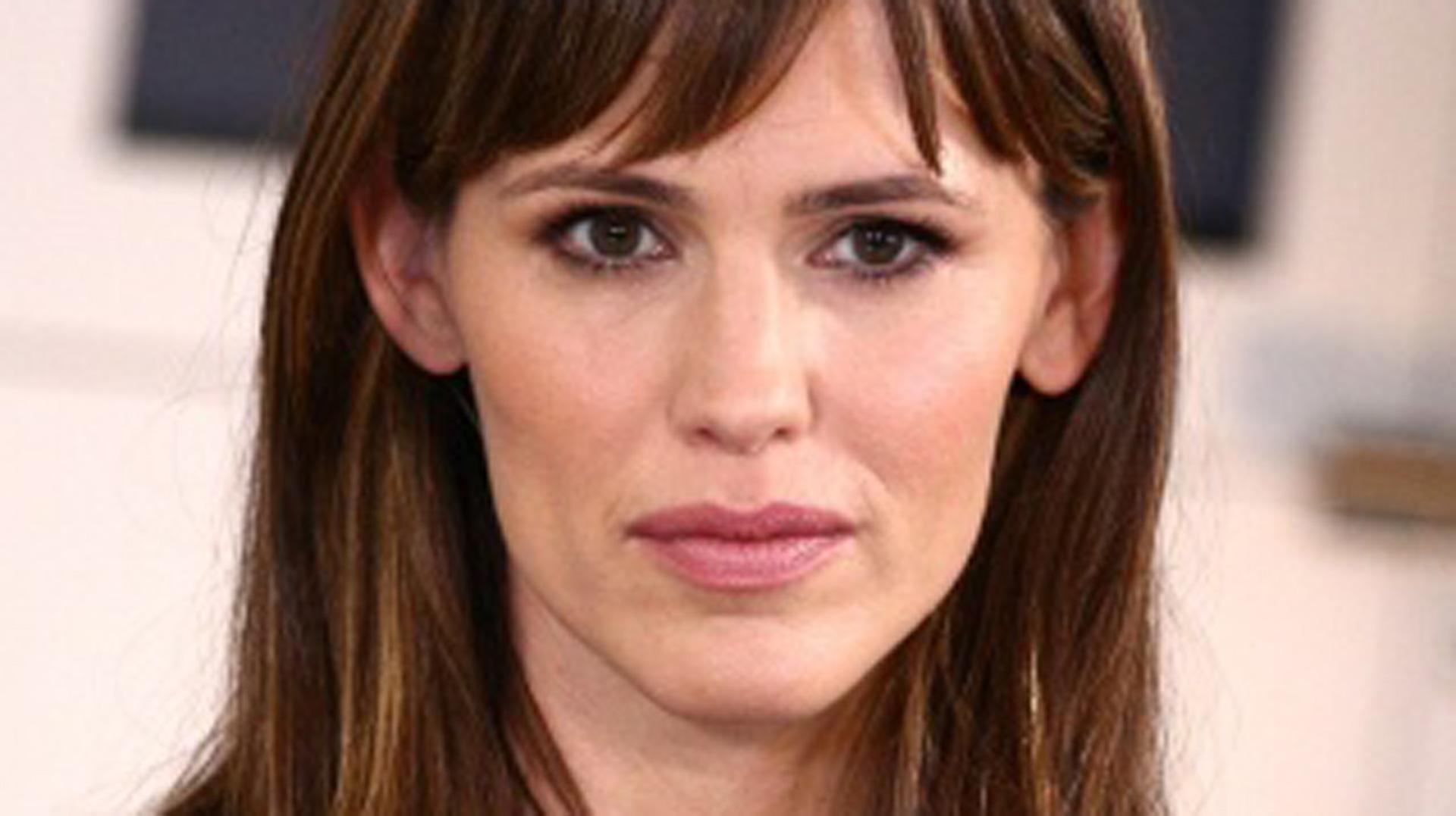
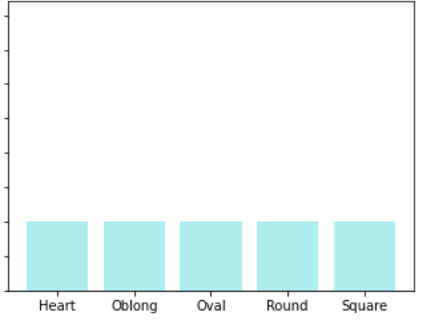
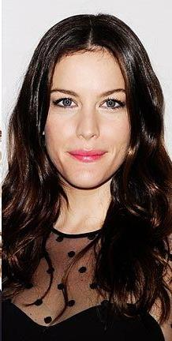
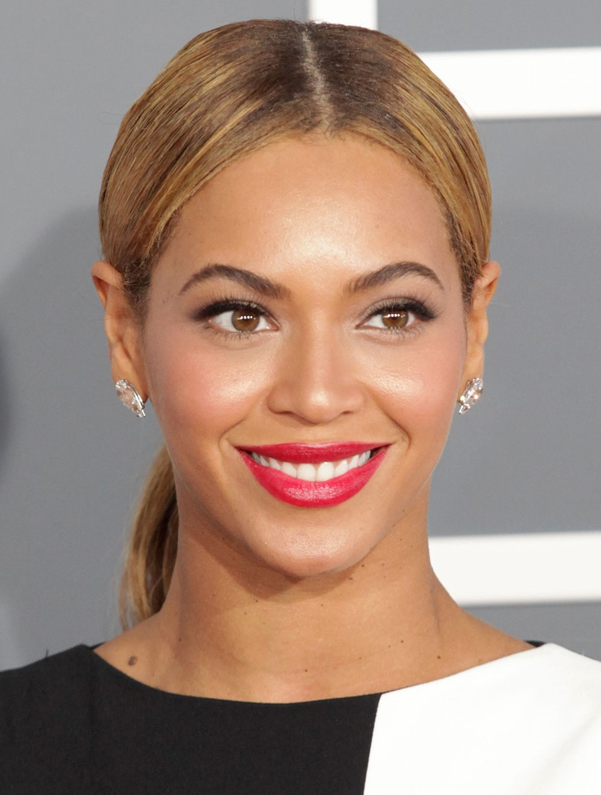
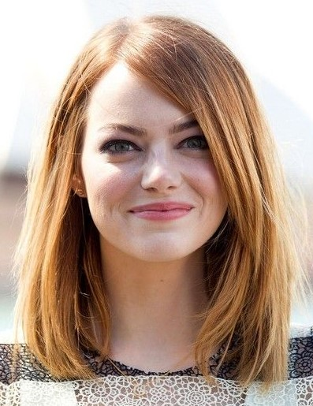
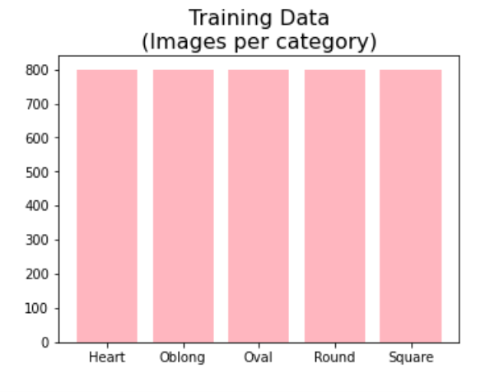
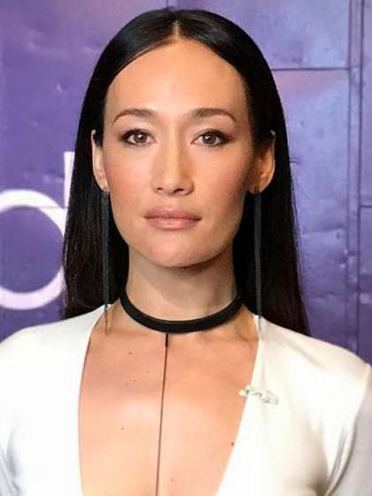
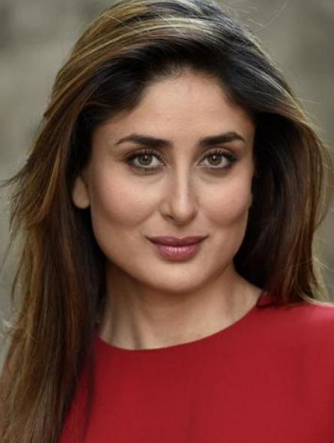
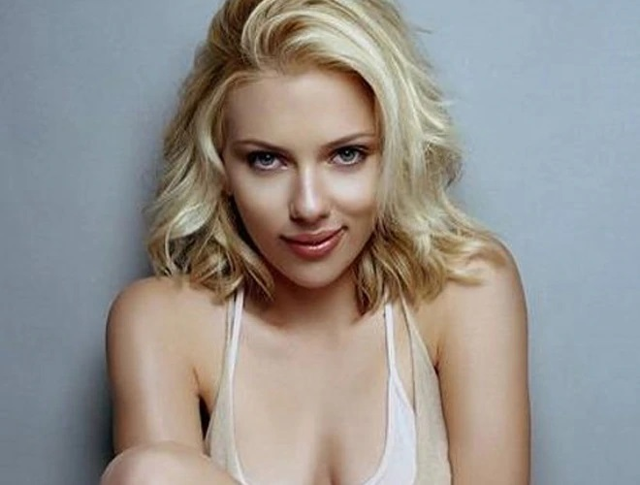
Data Exploratory Analysis
Testing Data
1000 images
(200 per class)
Training Data
4000 images
(800 per class)
Training Data:

Slide 7
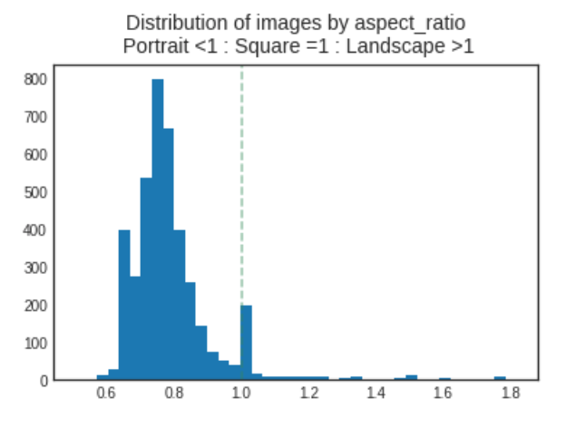
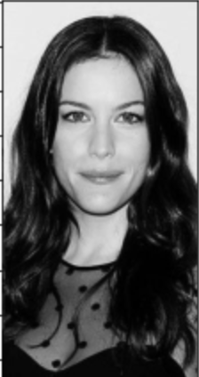
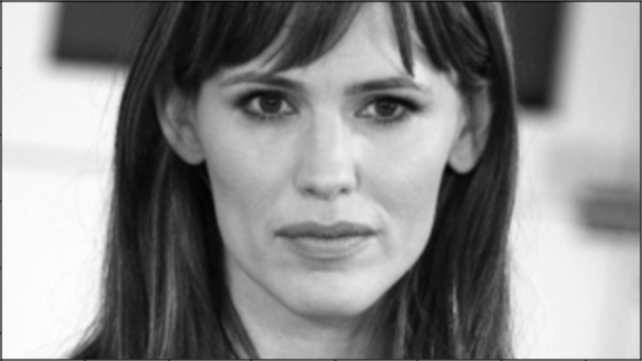
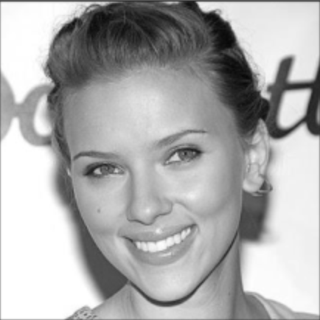
Images are mostly taken as portrait
(aspect ratio < 1)
Portrait
Landscape
Square = 1

Slide 8
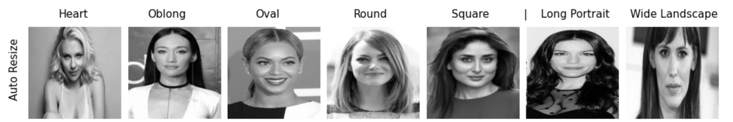
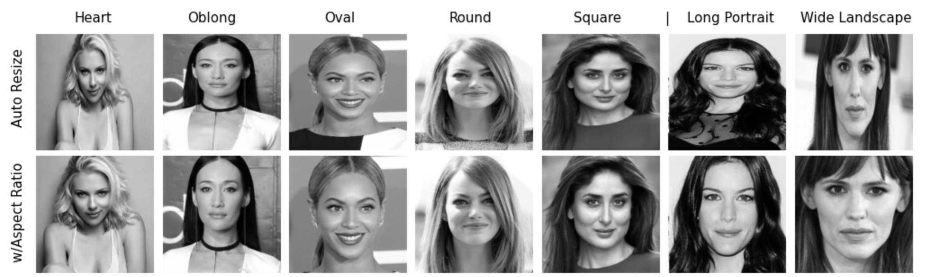
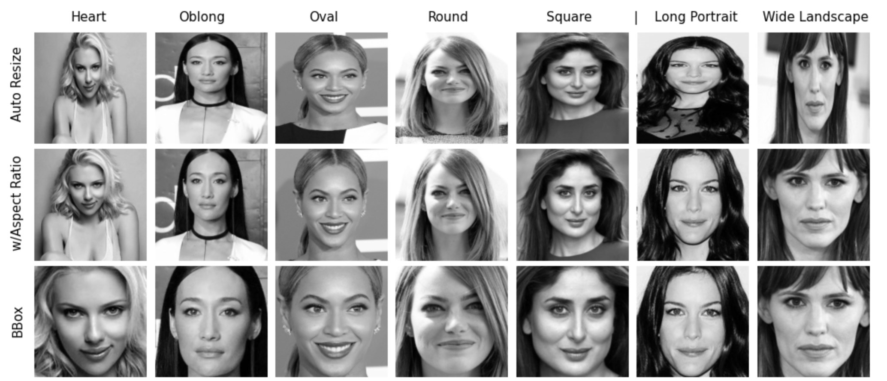
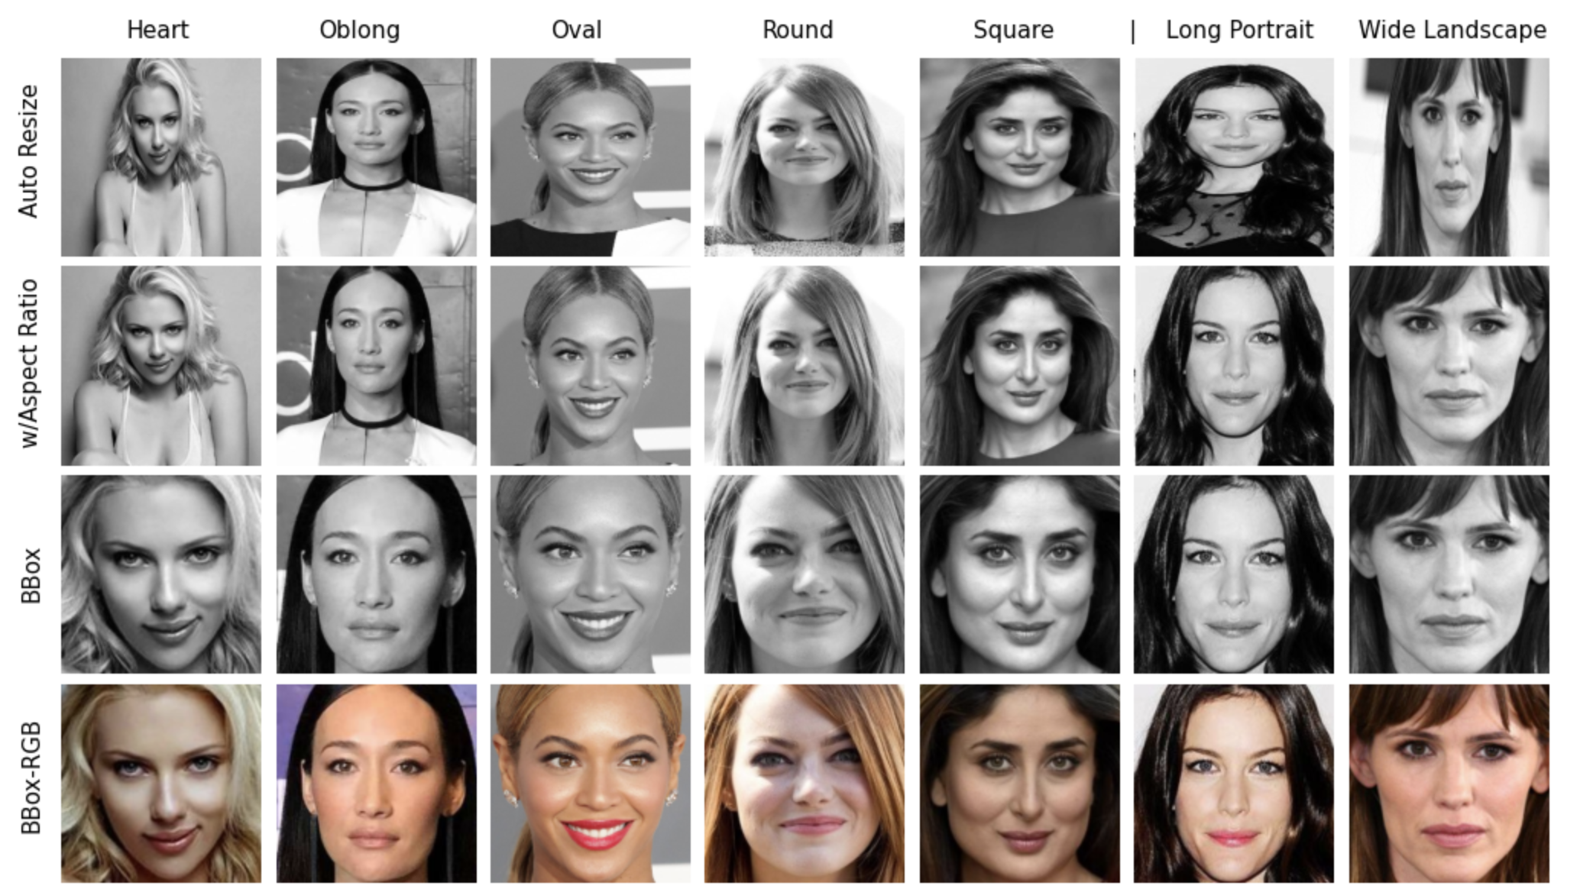
Image Preprocessing | Modelling
Baseline Accuracy = 20%
Training Validation
Accuracy Accuracy
73.90% 42.70%
72.50% 47.30%
76.73% 68.60%
94.17% 71.20%

Slide 9

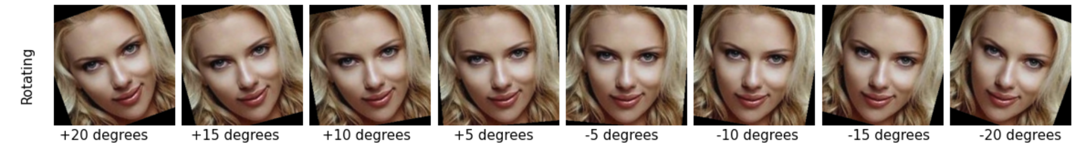
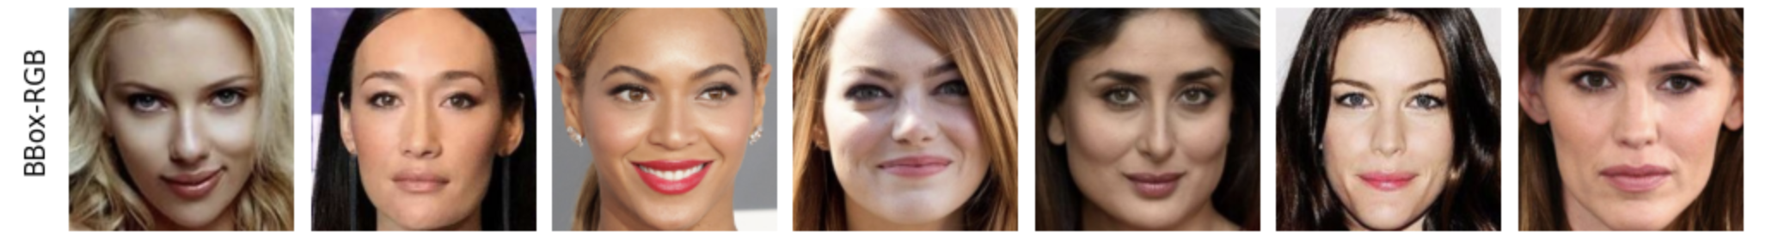
Image Preprocessing | Modelling
Baseline Accuracy = 20%
Training Validation
Accuracy Accuracy
80.20% 76.90%
94.17% 71.20%

Slide 10
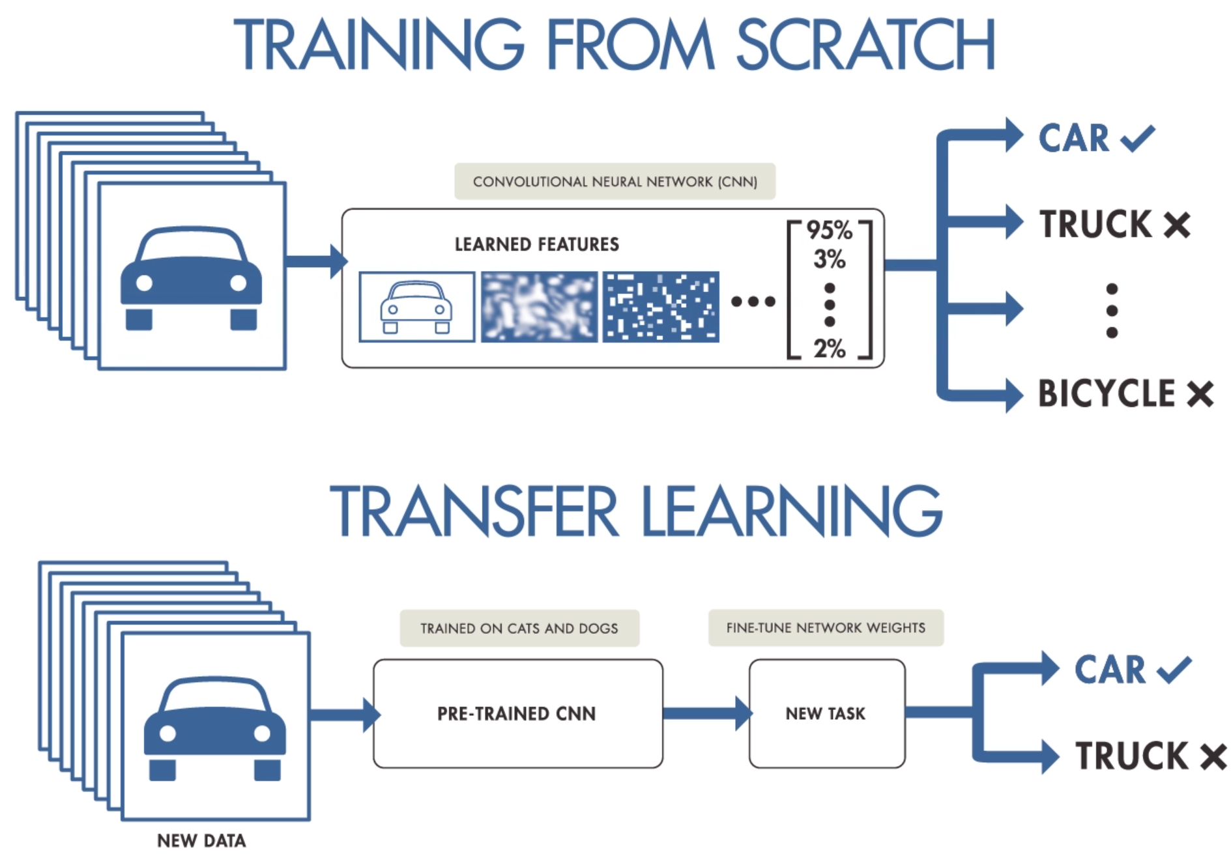

Slide 11
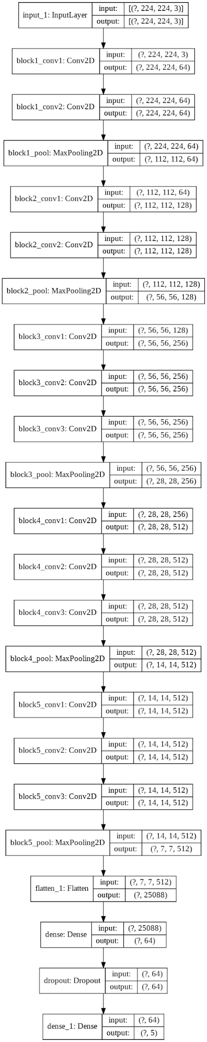
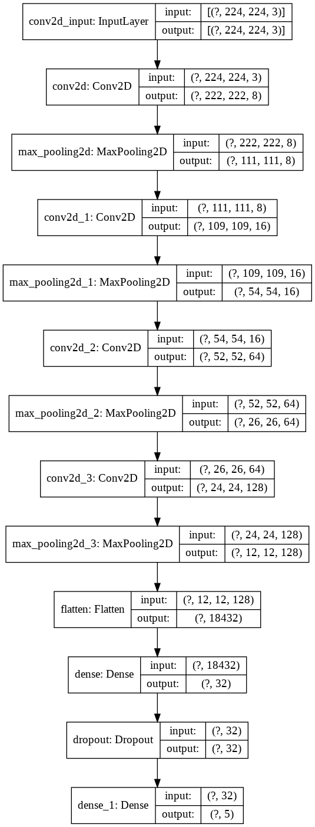
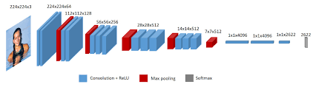
Transfer Learning VGG-FACE | Architecture
From Scratch VGG-16
VGG-Face pre-trained weights (trained on 2.6 Million images)

Slide 12
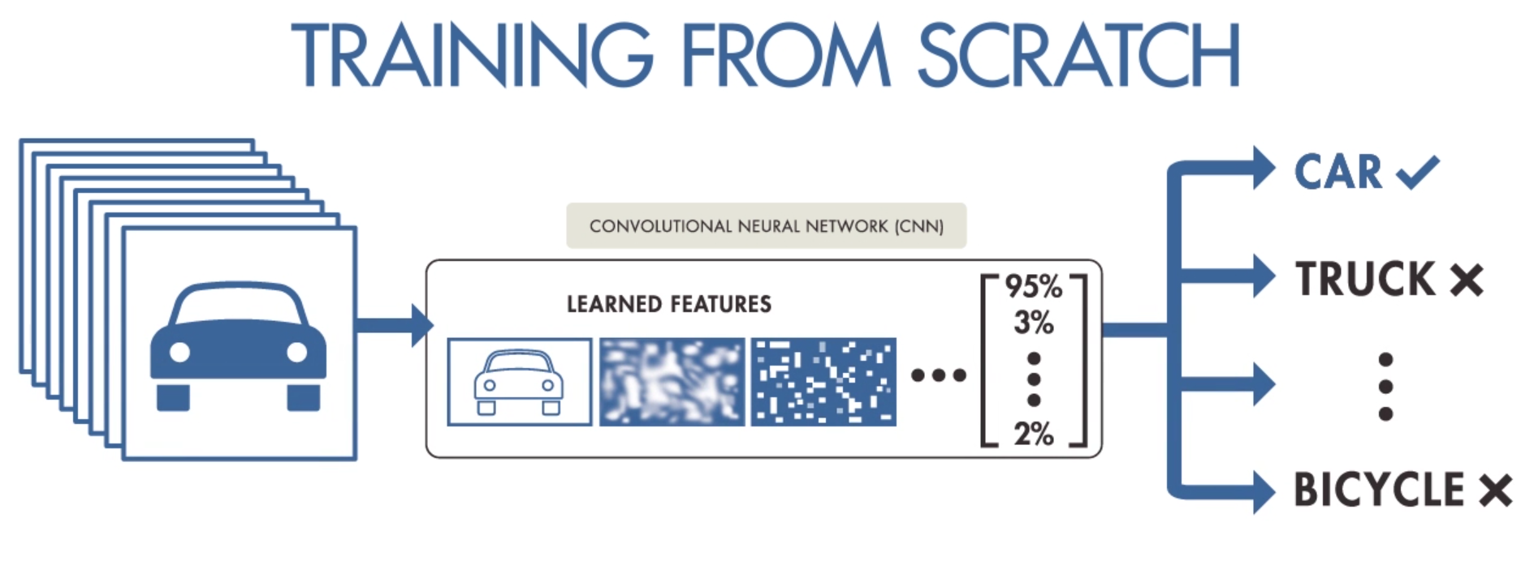
Modelling
Baseline Accuracy = 20%
Training Validation
Accuracy Accuracy
80.20% 76.90%
96.47% 92.70%
Notes:
From scratch 3.3% overfit
Transfer Learning 3.77% overfit

Slide 13

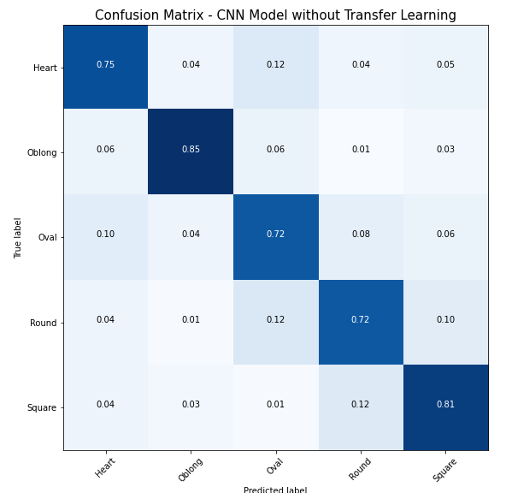
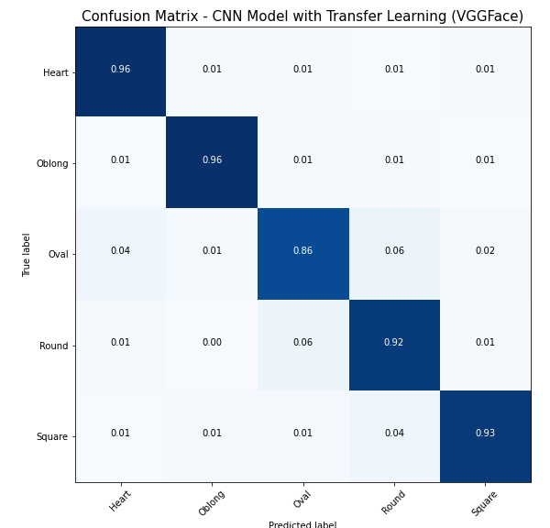
Confusion Matrix

Slide 14
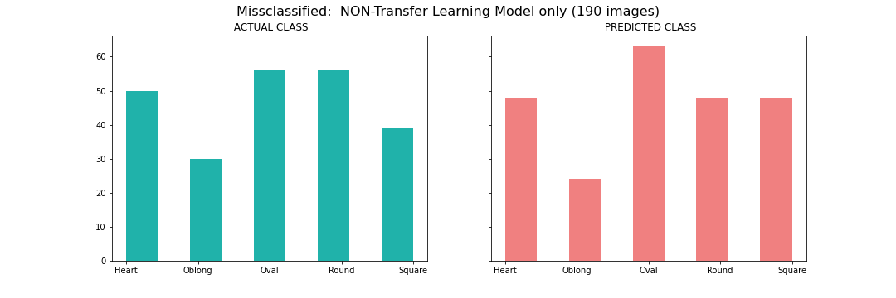
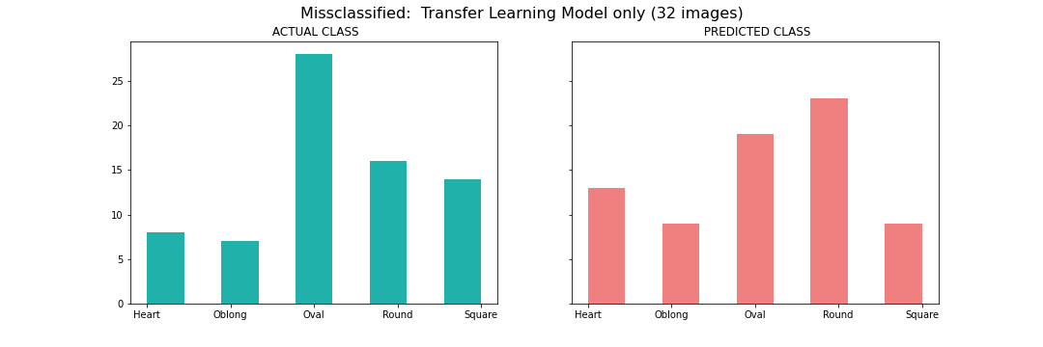
Misclassification Analysis

Slide 15
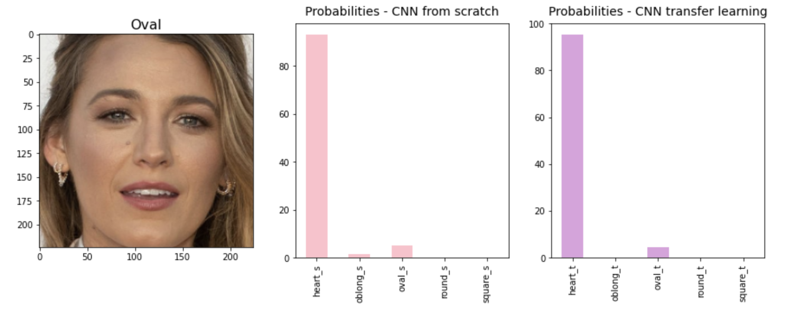
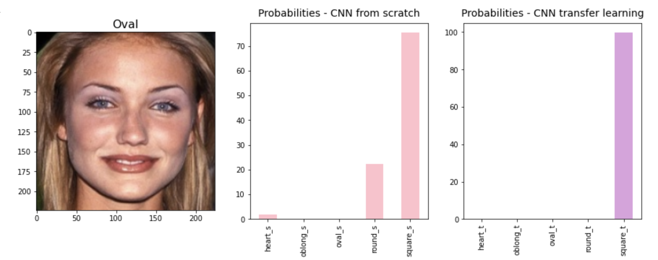
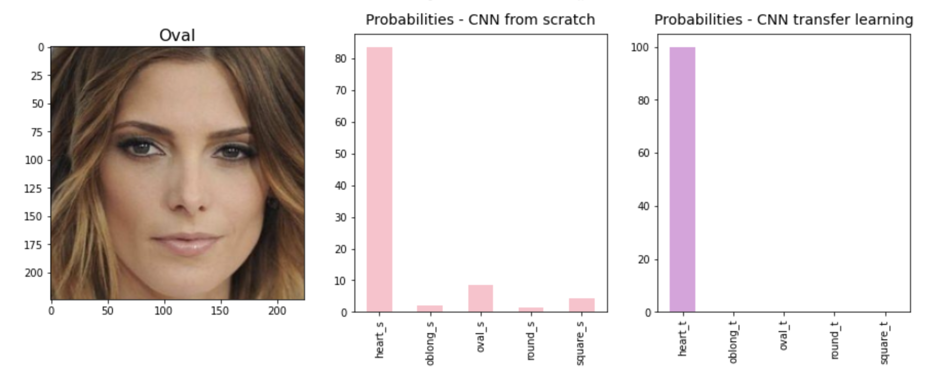
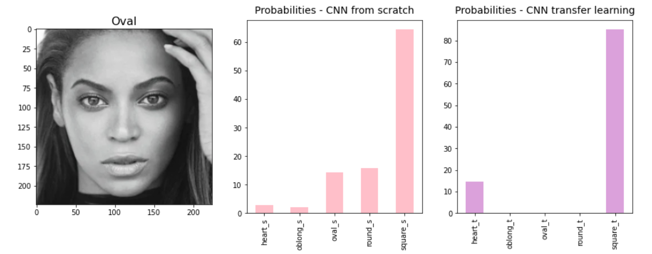
“Difficult” images misclassified by both models
Oval misclassified as Heart
Oval misclassified as Square

Slide 16
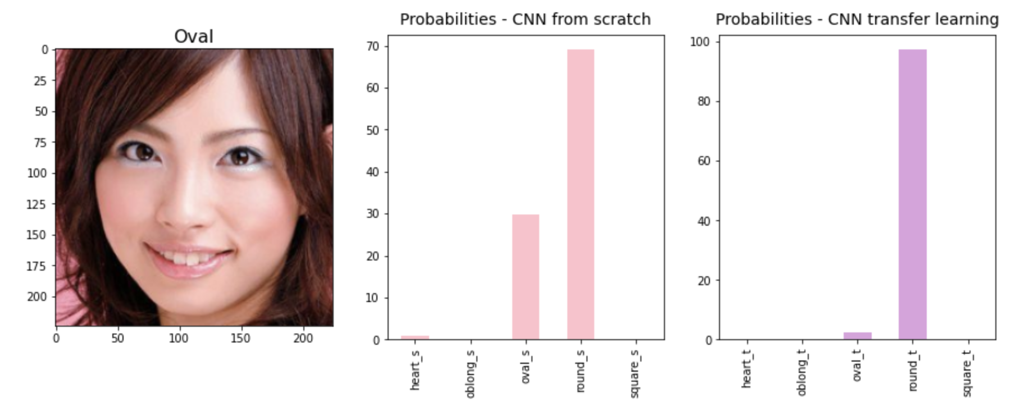
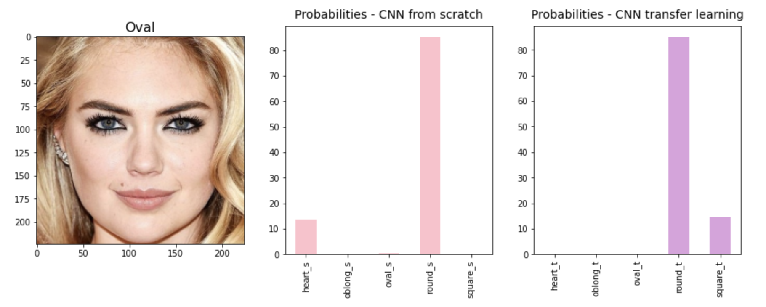
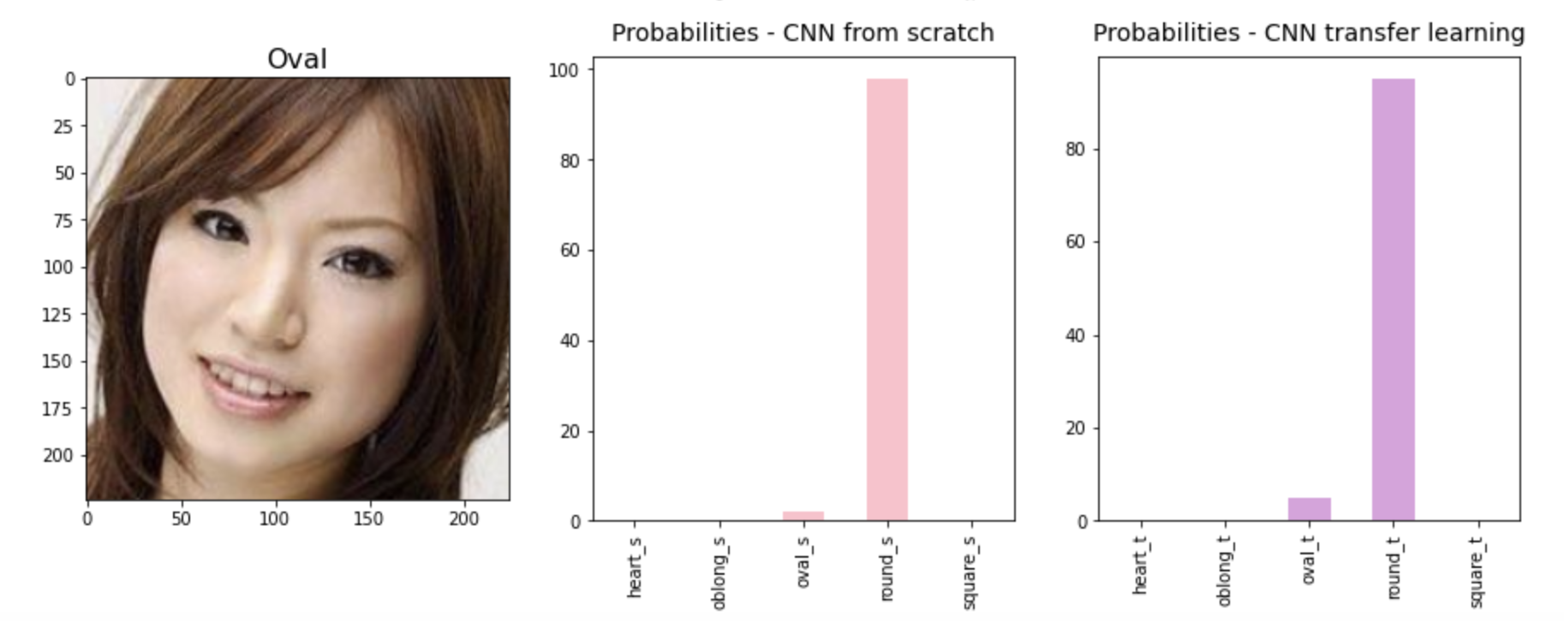
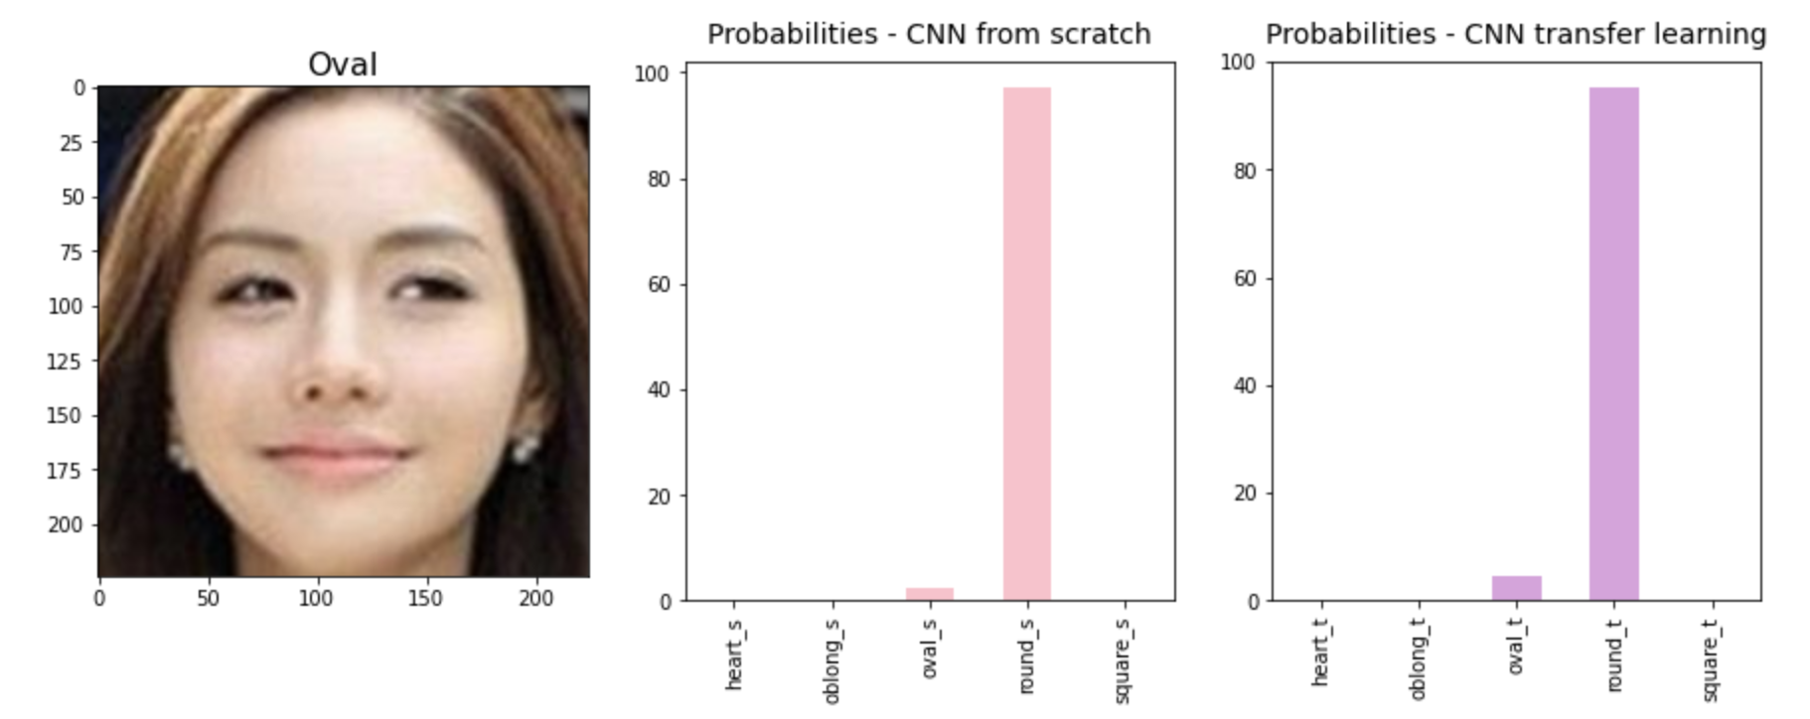
Mostly “Asian” Oval more mistaken as Round
Oval misclassified as Round

Slide 17
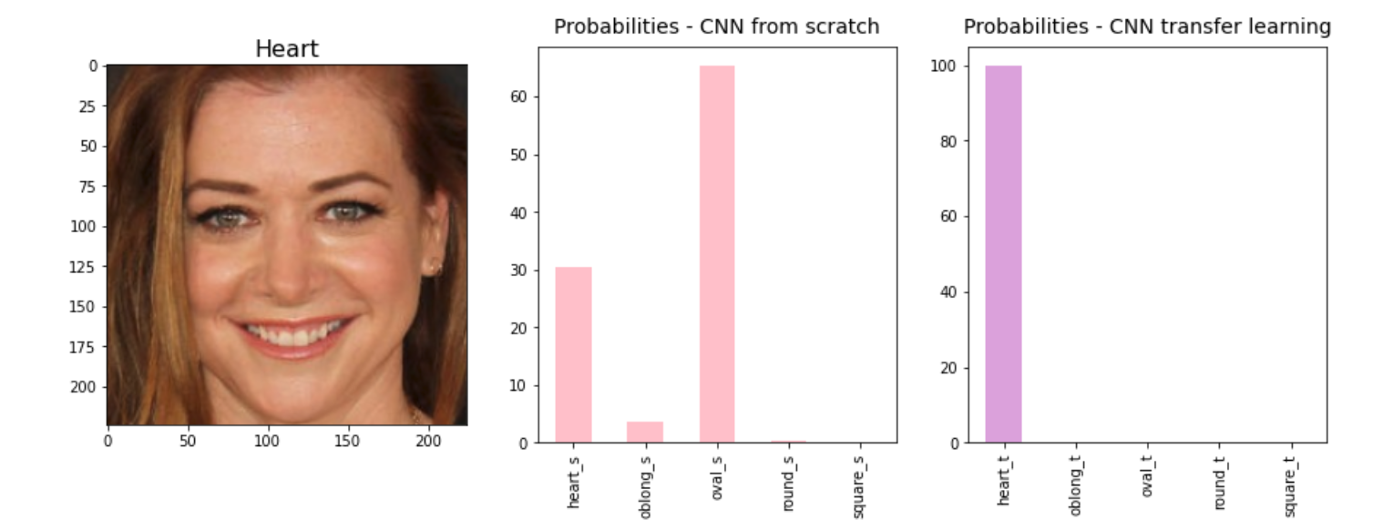
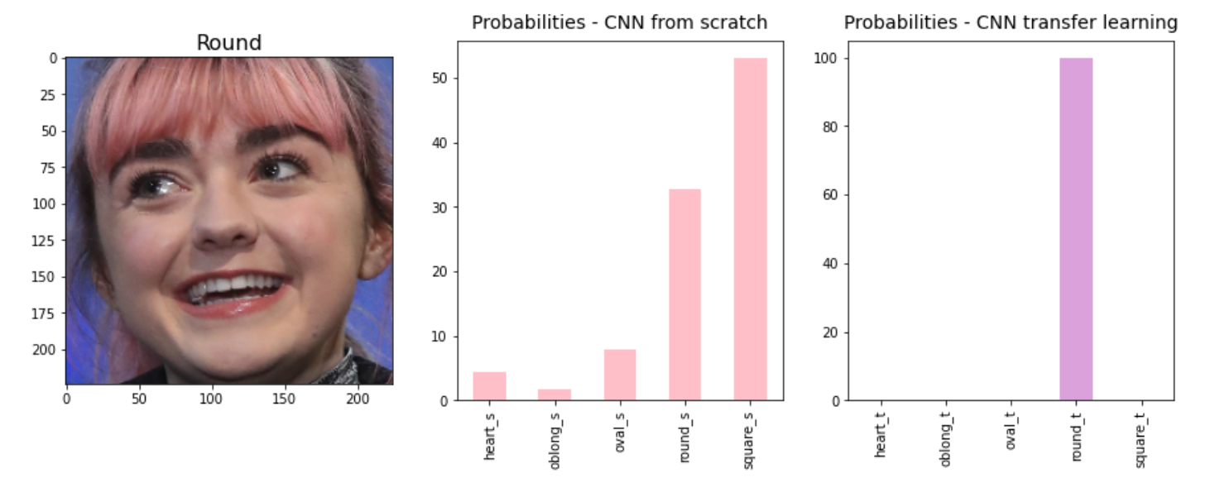
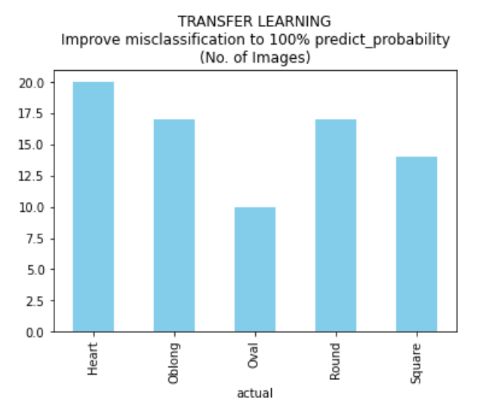
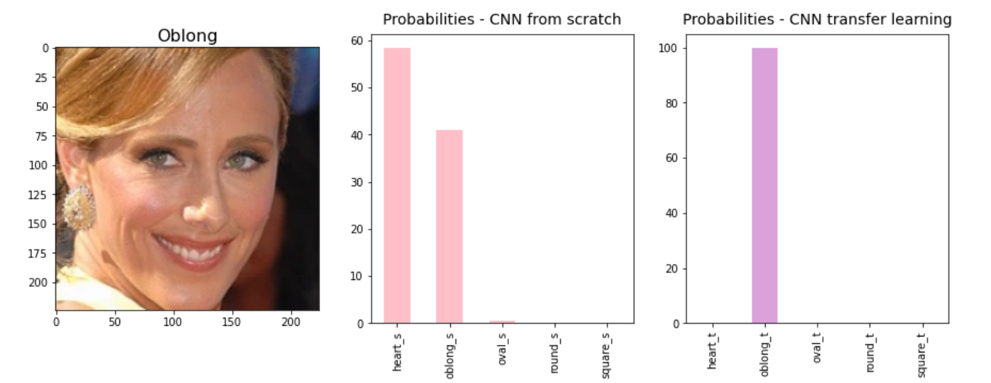
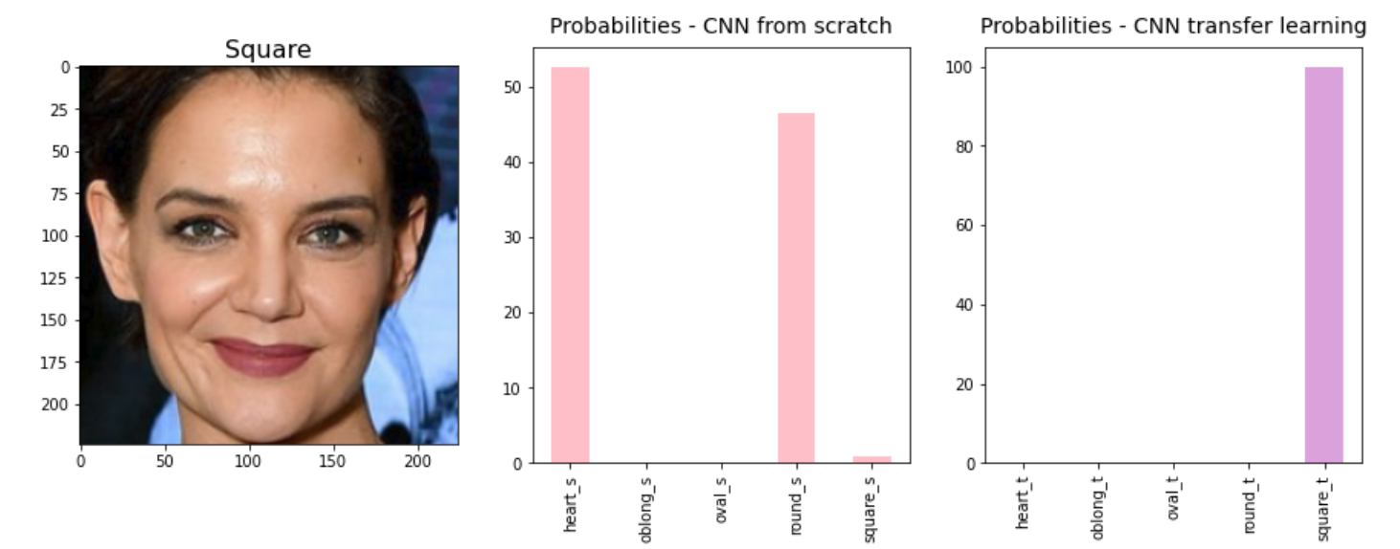
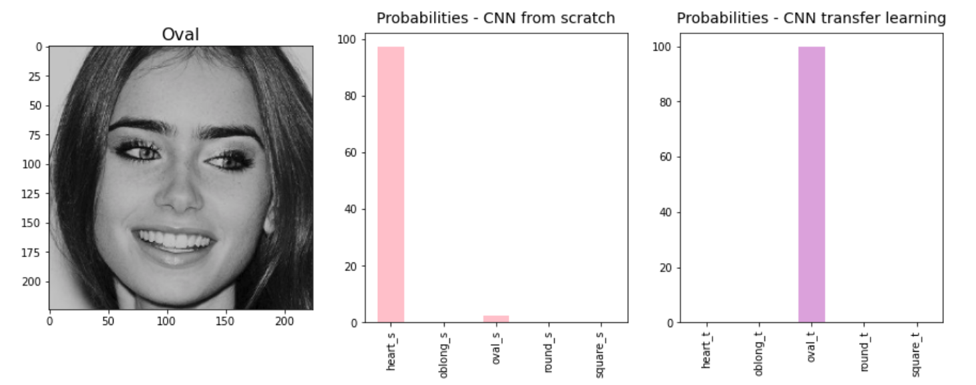
Transfer Learning improvement on some misclassified images to 100% probability of the predicted class

Slide 18


Predictions

Slide 19
Limitations
&
Way Forward
Trained on adult female faces
Lower accuracy on OVAL faces
Predictions depend on input image (angle, pose, cropping)
Opportunity to extend training
Male Face Shapes
Different ages and races
With/Without Glasses

Slide 20

https://github.com/Pratch-yani/Face_Shape_Classification https://drive.google.com/drive/folders/1r5cwyD55d33jSVSIJuZ2IguWynQ26Dq2?usp=sharing

Slide 21

Thank you :)

